Slide 1



Creating your first model
Using SKLearn’s datasets
Terry McCann | @SQLShark

Slide 2
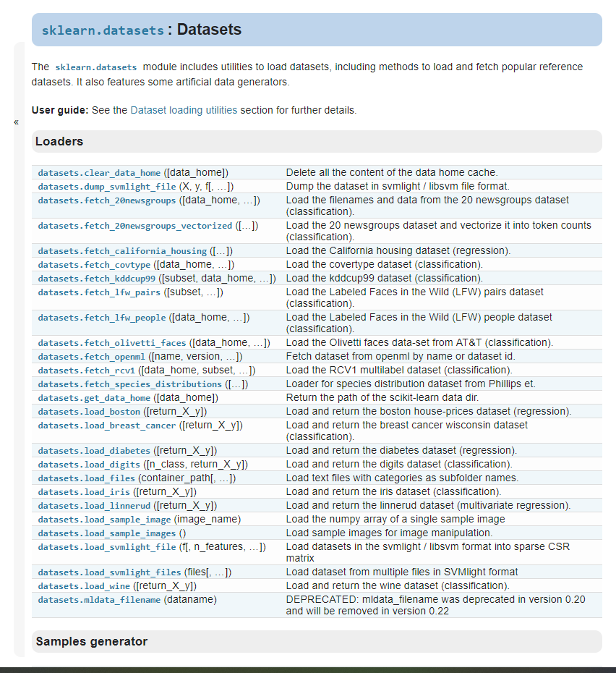
Sample Data
Diabetes data

Slide 3
data
Regression
Feature 2
Feature 1
Notes:
In simpler terms, Machine learning provides systems the ability to automatically learn and improve from experience without being explicitly programmed. It relies on underlying hypothesis of creating the model and tries to improve it by fitting more data into the model over time.

Slide 4
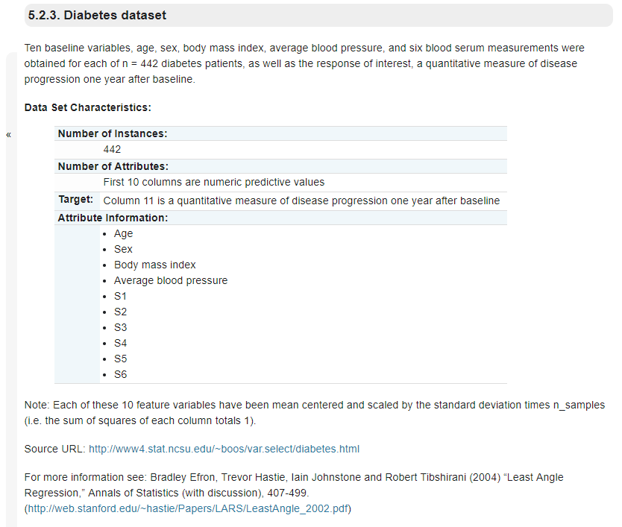

Slide 5
Demo – Exploring Diabetes Data

Slide 6
Lab 01 – Creating a model
15 minutes

